Slide 1
Memory

Slide 2
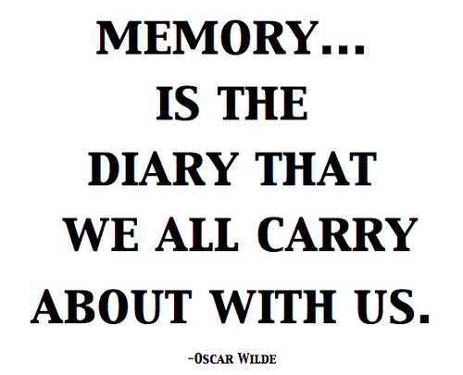
Memory
  Persistence of learning over time via the storage and retrieval of information

Slide 3
Functions of Memory
Gives us sense of self
Brings organization in life
Memory and adjustment
Memory and emotions
Memory and interpersonal relationship
Memory of trauma
Memory and decision making
Data sheet containing every detail of life
  However, what stored in the brain is far more than facts

Slide 4
Human Memory vs. Computer Memory
Brains are analogue; computers are digital
Content-addressable memory vs. byte-addressable memory
The brain as a parallel machine vs. computers as a modular and serial
Processing speed is not fixed in the brain; there is no system clock
Short-term memory is not like RAM
No hardware/software distinction can be made with respect to the brain or mind
Synapses are far more complex than electrical logic gates
Unlike computers, processing and memory are performed by the same components in the brain
The brain is a self-organizing system

Slide 5
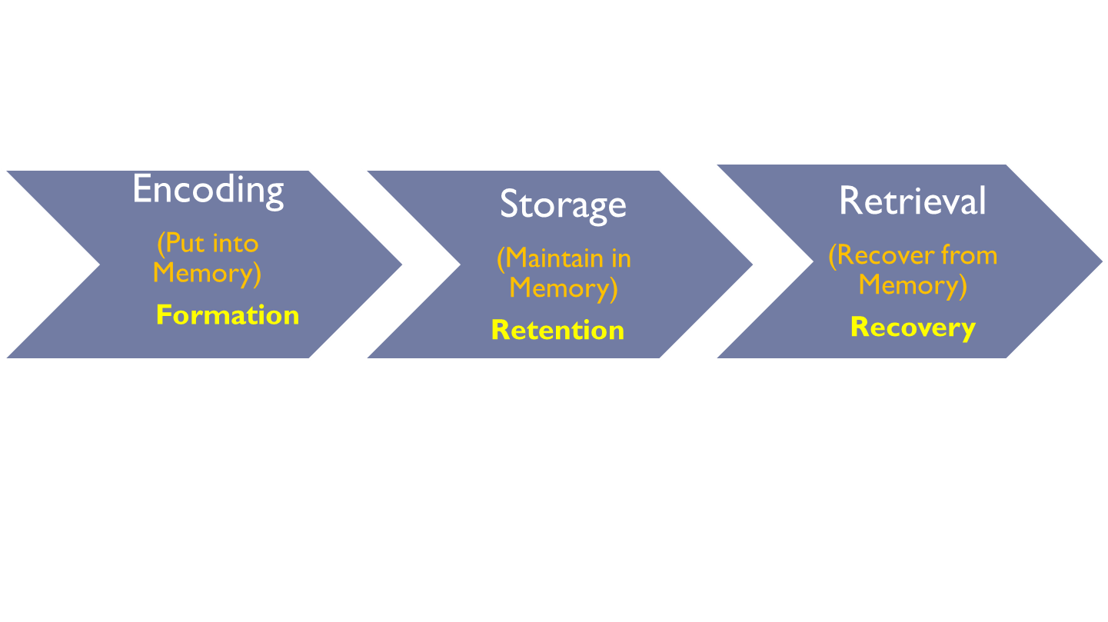
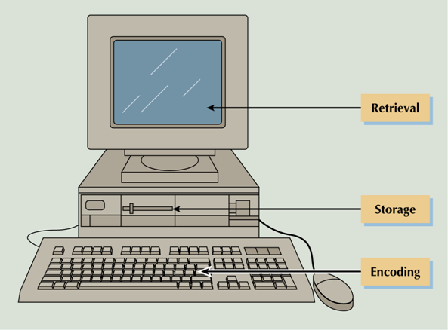
Three stages of Memory
      Encoding - the set of mental operations used to convert sensory information into a form that is usable in the brain’s storage systems.
      Storage - holding onto information for some period of time.
      Retrieval - getting information that is in storage into a form that can be used

Slide 6
Memory can fail at any of these three stages
Structures in the brain and different stages of memory
  PET (Positron emission tomography)
  f MRI ( Functional magnetic resonance imaging)
Encoding: Left hemisphere
Retrieval: Right hemisphere
Retrieval Cues
      Recall vs. Recognition

Slide 7
Encoding
Visual (picture)
  Process of encoding images and visual sensory information.
Acoustic/ Phonological (sound)
  Processing and encoding of sound, words and other auditory inputs.
Semantic (meaning)
  Process of encoding sensory input that has particular meaning or can be applied to a particular context, rather than deriving from a particular sense.

Slide 8







Storage: Three Memory Stores
Memory Output
Attended &
recognized
material
Long term Memory
Etc.
Etc.
Short term memory
Retrieval
Sensory Register
Rehearsal
A, A’, A’’, A”’, etc.
B, B’, B’’, B’’ etc.
Sensory
Input
C, C’, C’’, C”’ etc.
An Information processing Model of Memory (Atkinson & Shifrrin, 1968
Three memory stores differ in…
Capacity – How much information can be store
Duration – How long the information can be stored
Function – What is done with the stored informatin capacity and duration.
Notes:
Hockenbury slides (Schulman)
Key words: modal model of the mind; stage model of memory; sensory memory; short-term memory; working memory; long-term memory; attention; encoding; maintenance rehearsal; retrieval

Slide 9
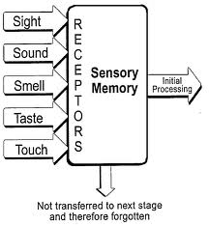
Sensory Memory
  The very first stage of memory
  The point at which information enters the
  nervous system through the sensory systems
  The capacity of sensory memory is very large,
but the information in it is unprocessed.

Slide 10
Sensory Memory: Types
  Iconic memory - Visual sensory memory, lasting only a fraction of a second.
    Capacity – Everything that can be seen at one time.
    Duration - Information that has just entered iconic memory will be pushed out very quickly by new information, a process called masking.
    Eidetic imagery - the rare ability to access a visual memory for 30 seconds or more.
      People with photographic memories are called eidetikers (eye-DET-ik-ers)

Slide 11
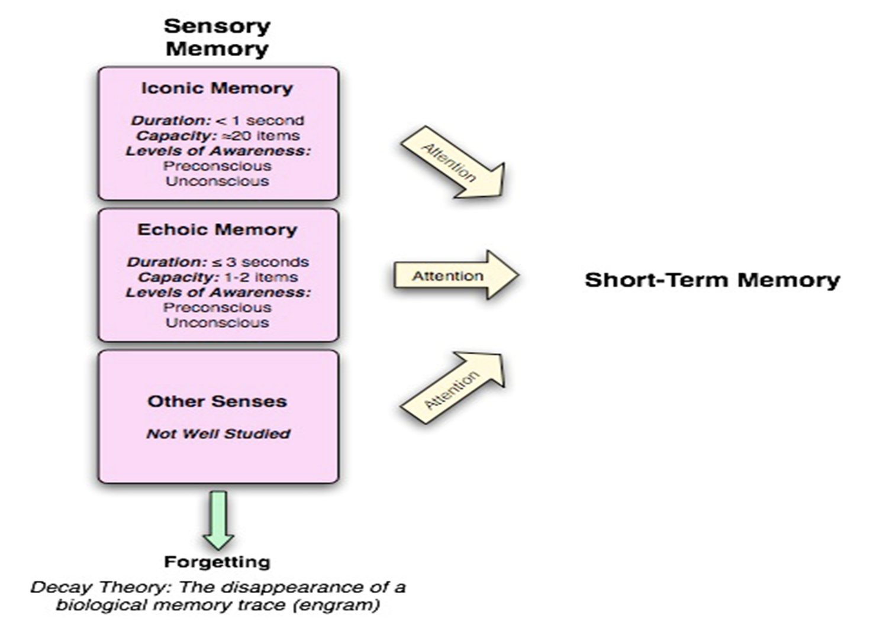
  Echoic memory –
  The brief memory of something a person has just heard.
    Capacity - Limited to what can be heard at any one moment
    Duration – Lasts longer than iconic — about 2 to 4 seconds

Slide 12
Short-Term Memory
Level of Awareness:
  Attention as the mental process that transfers information into the short-term store.
    STM is at the conscious level of awareness.
Maintenance rehearsal - Practice of saying some information to be remembered over and over in one’s head in order to maintain it in short-term memory
Encoding: Visual vs. phonological vs. Semantic?

Slide 13
Phonological Buffer vs. Visual-Spatial Sketchpad
  Left-Right hemispheric division
STM is susceptible to interference (e.g., if counting is interrupted, have to start over).
Storage: Seven pieces of information, plus or minus two items, or from five to nine bits of information.
      “magical number” = 7+_2

Slide 14
Test
Vase Teapot Camera
Tiger Book Ice Cream
Cushion Spade Cloud
Piano House Orange
Hat Table Book
Tree Shirt Cat

Slide 15
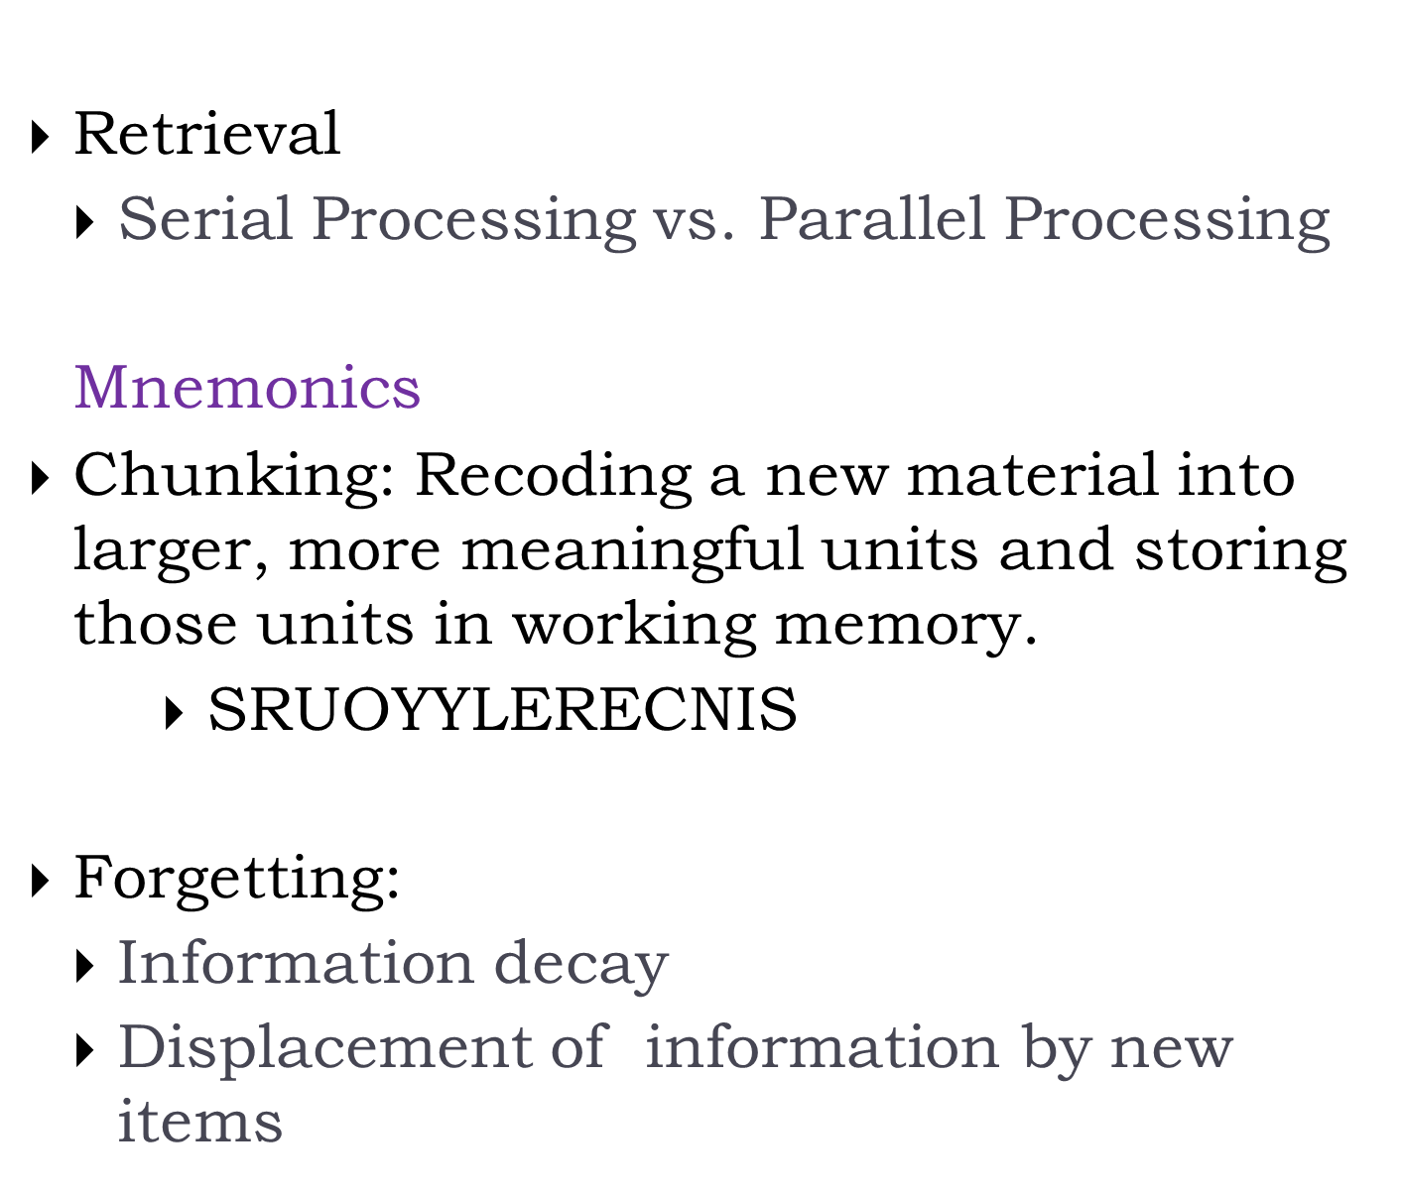

Slide 16
Mnemonics
A group of memory techniques, or mental ‘slights of hand’ that together facilitate the quick and easy assimilation of information of all kinds.
ACRONYMS: by using each first letter from a group of words to form a new word
SENTENCES/ACROSTICS. Instead of making a new word, use the letters to make a sentence.
  My Dear Aunt Sally (mathematical order of operations: Multiply and Divide before you Add and Subtract)
RHYMES & SONGS
METHOD OF LOCI
CHUNKING
Practice

Slide 17
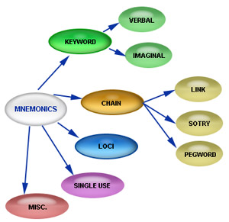

Slide 18
Functions of STM
Stores material needed for short term
Work space for mental computation
Serve as a way station to long term memory
Neurons in prefrontal lobed hold information for short term memory

Slide 19
Long-Term Memory
Long-term memory (LTM) - the system of memory into which all the information is placed to be kept more or less permanently.
Elaborative rehearsal - a method of transferring information from STM into LTM by making that information meaningful in some way.
Encoding: Acoustic vs Visual vs Semantic
Storage: Unlimited
Retrieval:
  Recall vs. Recognition? Which one is better?
  Serial search vs. parallel search

Slide 20
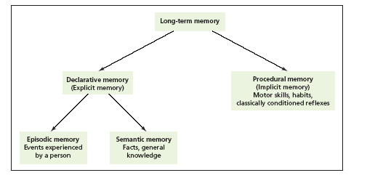
LTM

Slide 21
Types of LTM
Declarative memory – type of long-term memory containing information that is conscious and known (memory for facts).
Procedural (non-declarative) memory - type of long-term memory including memory for skills, procedures, habits, and conditioned responses. These memories are not conscious but are implied to exist because they affect conscious behavior.

Slide 22

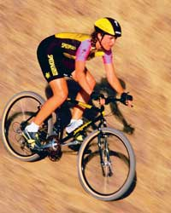
Procedural (Nondeclarative) LTM
Skills that people know how to do.
Also include emotional associations, habits, and simple conditioned reflexes that may or may not be in conscious awareness.
Anterograde amnesia - loss of memory from the point of injury or trauma forward, or the inability to form new long-term memories. Usually does NOT affect procedural LTM.
Procedural memory often called implicit memory - memory that is not easily brought into conscious awareness.

Slide 23
Declarative LTM
All the things that people know.
Semantic memory - type of declarative memory containing general knowledge, such as knowledge of language and information learned in formal education.
Episodic memory - type of declarative memory containing personal information not readily available to others, such as daily activities and events.
Semantic and episodic memories are forms of explicit memory - memory that is consciously known.

Slide 24
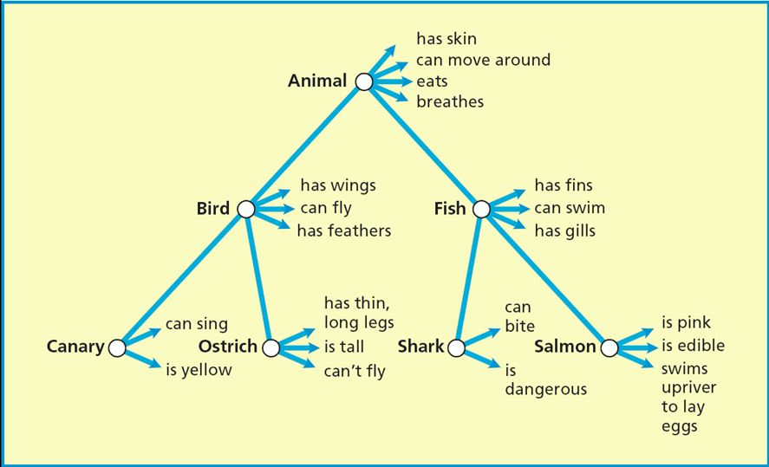

Slide 25
Say the following list of words once to yourself, and then, immediately thereafter, try to recall all the words, in any order, without looking back at them
Table,
cloud,
book,
tree,
shirt,
cat,
light,
bench,
chalk,
flower,
watch,
bat,
rug,
soap,
pillow
mosquito
magzine
toffee

Slide 26
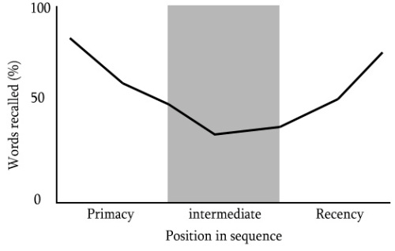
Evidence of STM and LTM
Serial Position Curve
  The position of an item in the list will affect memory for that item
Primacy effect. This is the tendency to remember well the first items in a list.
Recency effect. This is the tendency to remember well the last items in a list.

Slide 27
Forgetting and Memory Distortion
1. Interference theory
Two kinds of interference
  Retroactive interference
    Caused by activity occurring after we learn something but before we are asked to recall that thing
  Proactive interference
    The interference material occurs before, rather than after, learning of the to-be-remembered material
    In the Brown-Peterson task the trigrams learned earlier interfered with participants’ ability to remember later trigrams

Slide 28
The Constructive Nature of Memory
Eyewitness Testimony
  Experiments have shown people’s great susceptibility to distortion in eyewitness accounts
  Problems with wrongful conviction when using eyewitness testimony
  Lineups can lead to faulty conclusions
  It is clearly suspect in children because they are highly susceptible to suggestive questioning

Slide 29
Repressed Memories
  No compelling evidence points to the existence of such memories
Context Effects on Encoding and Retrieval
  Flashbulb memory
    Memory of an event so powerful that the person remembers the event as vividly as if it were preserved on film
  We remember better event with significant emotional intensity
  When information is encoded in various contexts, the information also seems to be retrieved more readily in various contexts

